Slide 1

Version Controlling & workflows with Git - I
Programming Applications And Frameworks (It3030)

Slide 2
Contents
Version Controlling: What?
What you know about Version Controlling
Version Controlling: Scenario Discussion
A bit of history on Version Controlling Systems (VCS)
Git: the de-facto standard today in VCS
Git Basic Concepts
Conclusion

Slide 3
Version Controlling: What?
“Version control is a system that records changes to a file or set of files over time so that you can recall specific versions later.” [1].

Slide 4
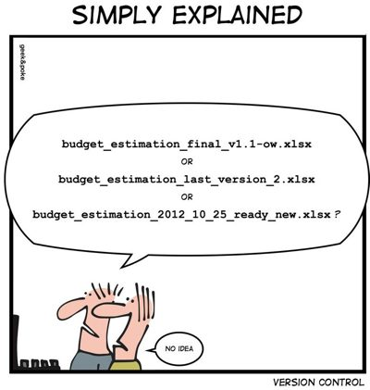
What you know about Version Controlling
Source: https://www.datamation.com/trends/tech-comics-version-control/

Slide 5
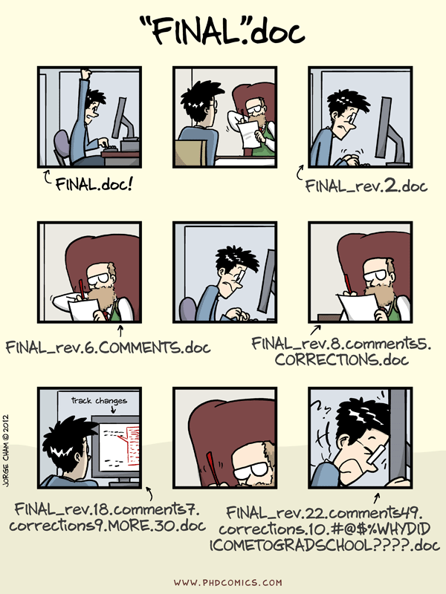
What you know about Version Controlling
Q: What methods of Version Controlling are you familiar with?
Keeping multiple copies of files with different names
Google Drive/ OneDrive
Undo/ Redo Buffer
Now, let’s see how one student named Amith does version controlling.
Source: https://swcarpentry.github.io/hg-novice/01-basics/

Slide 6
Version Controlling: Scenario Discussion
Suppose Amith is working on one file called numbers.py for an assignment.
Amith has worked on the file for several days now, and has saved multiple copies of the file, i.e., numbers1.py, numbers2.py, numbers3.py and numbers.py.
numbers.py is the latest version of the file. Whenever a new update is to be made to the file, first the existing numbers.py is renamed to numbersX.py (X = {1, 2, 3, 4…}) and then the numbers.py is saved with the most recent change.
Amith needs to submit the assignment now, but at the last moment he discovers that the numbers.py (most recent version) throws a serious error.

Slide 7
Version Controlling: Scenario Discussion
Q1: What can Amith do?
A: Amith can submit the one before (e.g.: numbers10.py).
Q2: What if the most recent version (numbers.py) has some good changes too, which Amith thinks needs to be in the submitted file?
A:
Compare numbers10.py and numbers.py and Copy the good parts.
Paste the copied code as fit in the appropriate places in numbers10.py.
Replace the numbers.py with this modified file.

Slide 8
Version Controlling: Scenario Discussion
The assignment was submitted. Now, Amith needs to keep this numbers.py and all its previous versions for future submissions too.
However, Amith has a nagging feeling about what will happen if the HDD of his laptop fails.
Q3: What can Amith do address this very valid concern?
A: Copy all the versions of numbers.py to a Cloud storage location (OneDrive/ Google Drive).

Slide 9
Version Controlling: Scenario Discussion
What are the pros of above approach?
All the versions are safely stored.
The files can be accessed from anywhere now.
The cons?
Considering accessing from anywhere: If Amith develops two versions of numbers.py (both named the same), one at the computer lab in his university (then uploaded to the cloud) and another numbers.py separately on his laptop, Amith runs the risk of replacing the version on laptop with the other if he uploads the first file without the name being changed when his laptop syncs with the cloud storage.

Slide 10
Version Controlling: Scenario Discussion
All in all, Amith now has a working Version Controlling System.
His system can,
Revert to a past version.
Compare two file versions.
Push changes done from anywhere to a secure remote location on the cloud.
Pull changes from the cloud to anywhere.
Merge different versions of files.

Slide 11
Version Controlling: Scenario Discussion
Now, Binesh joins Amith as the future assignments are to be done as pair work.
It is more important than ever to follow a strict discipline when using Amith’s system of version controlling as there are other people involved (than Amith).
However, just focusing on naming the files correctly (to avoid overwrites) is not enough.
Just seeing the files will not give each developer a high-level idea about what each other is doing.

Slide 12
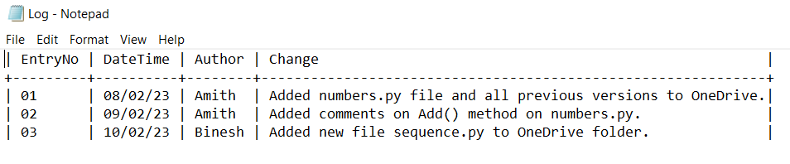
Version Controlling: Scenario Discussion
Solution?
A log file!
How?
The log file should contain information on who did what when so everybody would be aware of what is happening.

Slide 13
Version Controlling: Scenario Discussion
Does Amith’s method solve the problem of version controlling he had earlier?
Yes.
Does that mean it is an easy system to follow?
Not really. There are several specific rules the users of the system must follow in order to make it work.
As the number of users of this system increase, so does the chance of someone making a mistake and ruining the system for everybody.
Should he follow this approach then?
Yes, it’s a good system. But the management of the system should not be given to the users. It should be automated.
Are there such automated systems already?
Yes! That’s what version controlling systems like GIT, SVN and Mercurial do.

Slide 14
A bit of history on Version Controlling Systems (VCS)
The first proper Version Control System (VCS), named Source Code Control System (SCCS) was released in 1973 by Bell Labs.
It was a first-generation VCS, which are now collectively known as Local Version Control Systems.
Local VCS were intended to track changes for individual files and checked-out files could only be edited locally by one user at a time.
Facilitating collaboration among large teams was problematic.

Slide 15
A bit of history on Version Controlling Systems (VCS)
To address the problem of collaboration, a new type of VCS were developed.
This second generation of VCS are collectively known as Centralized Version Control Systems.
Centralized VCS allowed users to refer files stored on a centralized repository through a network and allowed multiple users to use the files concurrently.
Follows a Client-Server approach.
However, they would all have to commit their code to the centralized repository, which would require network access.
A central authority is required to maintain the Centralized repository.

Slide 16
A bit of history on Version Controlling Systems (VCS)
With the advent of open-source software came the third generation of VCS. They are collectively known as Distributed Version Control Systems.
The earlier Centralized VCS required a central authority to maintain the centralized repository. No such authorities are usually found in open-source projects.
Instead, there are just contributors who may develop features which may or may not be relevant to the main open-source project.
Therefore, Distributed VCS have peer-to-peer (P2P) approach to version controlling.
Distributed VCS are widely used today.
De-facto standard in Distributed VCS now?
Git!

Slide 17
Git: the de-facto standard today in VCS
Created by Linus Torvalds (creator of Linux) in 2005.
Pronounced as Ghi-T. Not Ji-T (A "git" is a cranky old man. According to online sources, Linus meant himself).
Originally designed to do version control on Linux kernel.
Git supports non-linear development (thousands of parallel branches) and is fully distributed.

Slide 18
Git Basic Concepts
As mentioned, git does not necessarily need a Centralized Repository to work (It can work in somewhat centralized manner too, which we will see).
Every user maintains a local repository of their own.
When starting out they will obtain this local repository,
from another user or,
they may clone it from a central location or,
They may even initialize a brand-new repository from scratch.
This repository will contain what others have done originally, what the user has done themselves and even work of others as selected by the user.
They can commit and update their local repository without any interference from any others.

Slide 19
Git Concepts
Git has two types of repositories.
Local repositories – which is owned by each user.
Remote repository – a centralized location accessible to all users. A single source of truth.
The users will push their new updates to this repository so those can be shared with others as well.
The users will pull new updates from others from this repository.
Why do we need Remote repositories?
Scenario Discussion: The problem with Distributed Version Controlling. Which project is the “right” project when multiple versions of the project exist?
Solution? Remote repositories as a single source of truth!
Git != GitHub (Git is not Github)!

Slide 20
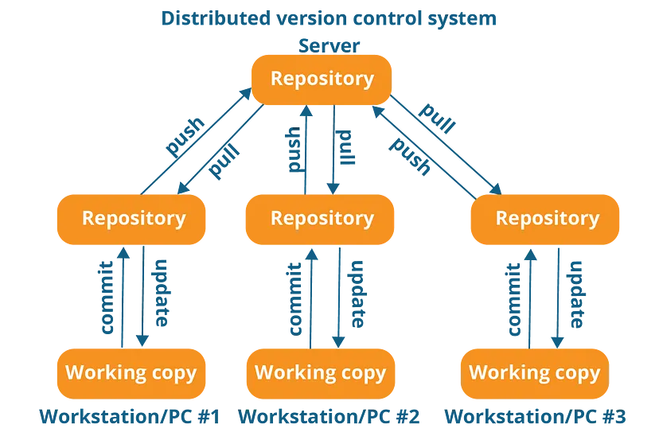
Git Concepts
Source: https://medium.com/@sahoosunilkumar/how-does-git-works-5cc8444ea383

Slide 21
Git Concepts
Git works on Commits.
A Commit is very simply a snapshot of all changes in the local repository (more correctly, the working directory).
Each Commit has a unique Commit ID.
A Commit ID is a unique SHA-1 hash that is created whenever a new commit is recorded.
The most recent commit is called the Head (more correctly, it refers to the currently checked-out branch's latest commit).
For now, we will only deal with main/ master Branch.
We will extensively deal with Commit IDs for many operations on git (more on this later).
Source: https://medium.com/@sahoosunilkumar/how-does-git-works-5cc8444ea383

Slide 22
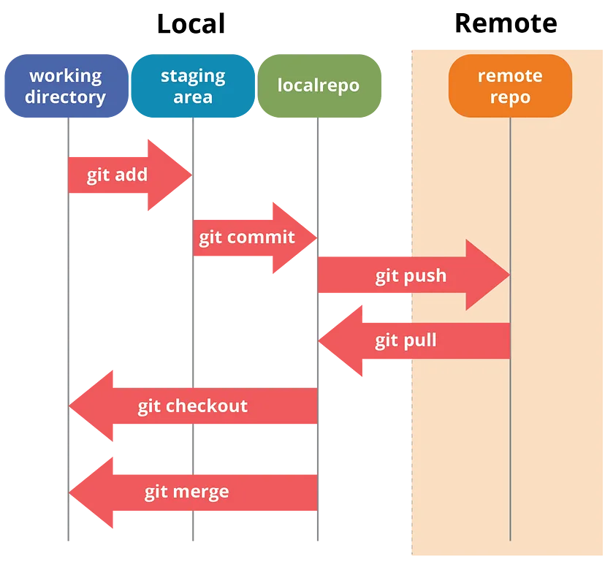
Git Concepts
Add a new file to the local Repo.
Do the required changes to the file.
Commit the file to the local repo.
Pull the changes from the remote repo.
Push the local changes to the remote repo.
Source: https://medium.com/@sahoosunilkumar/how-does-git-works-5cc8444ea383

Slide 23
Scenario Revisited
Refer back to Amith’s version controlling method in the beginning. It could,
Revert to a past version.
Compare & Merge two different versions of files.
Pull changes from a remote location to anywhere.
Push changes done from anywhere to a secure remote location.
Use the Log file to keep track of all the events.
All these actions can be easily accomplished using Git.
Revert – git revert (this reverts a commit that was made to the repository).
Compare & Merge – Automatically handled by git. No user intervention required most of the time (unless a conflict occurs).
Push and Pull – Update the Upstream and get updates from upstream.
Git has many ways of automatically keeping track of all the events (e.g.: git status, log, blame etc.)

Slide 24
Next week
Branching
Best Practices
Pull Requests
Git Workflows

Slide 25
References
Pro Git - Scott Chacon and Ben Straub [Free eBook]
Dangit, Git!?! [Git quick reference]
Reading 5: Version Control [MIT Lecture]
Distributed Version Control [Wikipedia]
History of Version Control Systems

Slide 26

Thank You
Vishan.j@sliit.lk
nelum.a@sliit.lk

